Slide 1
CDM PoA Development Case Study: Morocco Municipal Solid Waste

Slide 2
Context
Morocco generates 6.7 million tons of MSW per year
Despite progress, half of this waste is still disposed of in open dumps
SWM services are the legal responsibility of the municipality
Private sector participation in street cleaning, waste collection, and land-filling services

Slide 3
An Ambitious Sector Reform
Solid Waste Management Law 2800 (December 2006)
National Solid Waste Program, covering a range of institutional, financial, environmental, and social upgrading actions over15 years
Introduction of sanitary landfills (100% of urban areas equipped by 2022), and closure and rehabilitation of 300 existing open dumps.

Slide 4
Barriers to CDM Development
Despite continuous CDM progress since 2003, no landfill project has yet been developed in Morocco…
Complex and time-consuming CDM development process
Limited local capacity to assess and implement CDM projects
No specific national guidelines for cities on development procedures and legal setup for CDM projects

Slide 5
Why a PoA ?
The PoA approach based a coordinating entity helps cities navigate complex CDM development procedures to benefit from the carbon revenues
The PoA approach helps achieve the scale necessary for the optimal centralized management setup that can benefit from technical assistance and support from the WB CPF
By building CF capacity in FEC, the PoA can play a catalytic and replicable role in promoting municipal CDM projects

Slide 6
PoA for CDM Development
Source of Emission Reduction: reducing methane emissions from landfills through landfill gas (LFG) capture, for flaring or grid electricity generation
Methodology for large-scale LFG activities (ACM 0001)
Support and technical assistance for the management and legal setup of CDM projects
A partnership framework for CER PoA handling and transfer (WB CPF)

Slide 7
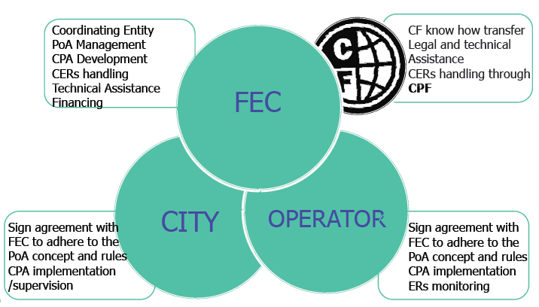
Key Actors
The PoA is managed by Fonds d’Equipement Communal (FEC), a State-owned municipal bank mandated by the Government to assist municipalities in developing CDM projects and selling Emission Reductions, by providing them with technical assistance for CPA implementation, CDM development and CER handling

Slide 8
Lessons Learned
Start PoA early
Stick to the CDM rules and the procedures in developing the PoA
Find a champion, with legitimacy and capacity
Pursue international partnerships for CF capacity building and knowledge transfer
Develop a strong contractual, procedural, and legal framework
Work on the technical, legal, commercial, and marketing aspects simultaneously

Slide 9
Conclusions
Local urban development programs offer significant CDM opportunities
The experience of the SWM PoA and CF framework has given FEC the capacity and positioning to tap into this CDM potential and develop new PoAs
The new city-wide CDM programmatic approach promoted by the WB offers an opportunity to develop new CDM activities

Slide 10
pcohen1@worldbank.org
Thank you!

