Slide 1
World Bank Institute - Cities and Climate Change Program Sao Paulo City Hall, CFCB Workshop May 4, 2010
Konrad von Ritter, Practice Manager
WBI Climate Change

Slide 2
World Bank Institute
Capacity Building and Learning Arm of World Bank
Climate Change Practice created 2009
Mitigation and Adapation
Special Focus Cities and Climate Change

Slide 3
Program: Cities and Climate Change
Clients:
Policy/Decision Makers, Parliamentarians, Practitioners in multi-sectors, city networks
Partners:
e.g. Urban Anchor, ENVCC, WBIUR, WBILT; ICLEI, UCLG, C40, Cities Alliance; Spain, Switzerland
2009/10
Key Achievements
WBI Business Lines
2010/11
Priorities
Structured Learning &
Partnership Development
Kick-off 3 modules (Cities & CC, Energy, POA)
Regional Hub
Cities & CC
e-learning program
Dialogue Urban Pov. & CC
Carbon Expo
Reg. Works. POA for Cities
Knowledge Exchange
Task Force Urban Poverty & CC
City-Twinning
On-the-ground Support
CFCB - customized
(Sao Paolo, others )
Case studies Urban Poverty & CC (S.P. et al.)
CFCB – Carbon Finance in Megacities ( Sao Paulo, others)
Results: Cities are capable of integrating programmatic carbon finance, climate resilience, and low carbon strategies into their development planning.

Slide 4
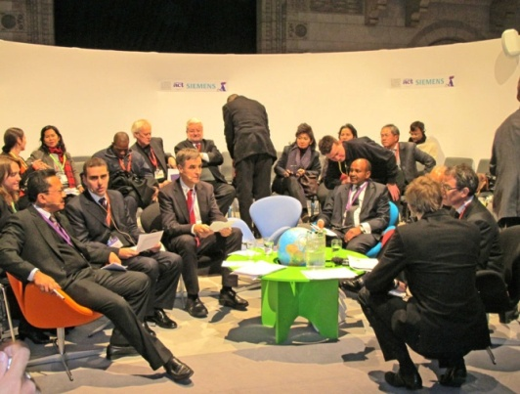
Mayor’s Taskforce on Urban Poverty and Climate Change
Initiative of Mayors from 5 Megacities to address urban poverty in a climate smart way
Conceived at COP 15 Copenhagen Mayors Summit
Members incl. Mayors of São Paulo, Dar es Salaam, Jakarta, Mexico City, and of Toronto (Chair of C-40)
Support Team: World Bank and partners, incl.
Mr. Robert B. Zoellick, President of the WB

Slide 5
Mayors’ Task Force (TF) on Urban Poverty and Climate Change
Objectives:
Undertake analytical study on linkages between urban poverty and climate change
Conduct four city case studies on urban poverty and climate change
Scale-up climate smart urban poverty programs, incl. climate financing

Slide 6
Mayors’ Task Force (TF) on Urban Poverty and Climate Change
Next Steps:
Commencing City Case Study in Sao Paulo – May 2010
Establishing partnerships with local institutions and forming a team including local experts and the WB staff
Agree on Scope of urban poverty and climate change topics and key issues
Closely linked to World Bank – Sao Paulo “Green Cities Development” Work
Progress Reports
ICLEI Resilient Cities Congress in Bonn in May 2010
Pre-COP16 meeting in Cancun, Mexico in November 2010
Presentation
C-40 summit in São Paulo in Spring 2011

Slide 7
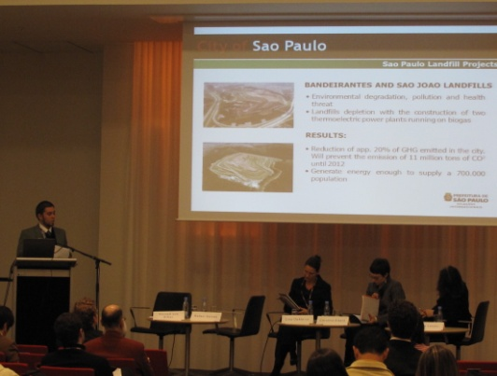
Carbon Finance Capacity Building (CFCB) in Megacities of the South
Goal: strengthen city governments’ knowledge of carbon finance and assist with program development

Slide 8
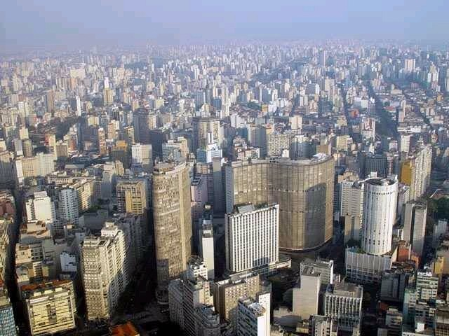
Project portfolio and Project Examples
The CFCB has signed LOIs with four cities in which projects are actively being developed: Dar es Salaam, Jakarta, Quezon City, São Paolo
Work is also being commenced on the CFCB City Group in South Africa and India
CFCB project examples
Jakarta, Indonesia
Waste Management
Quezon City, Philippines
Implementation of efficient street lighting
Dar es Salaam, Tanzania
Briquetting stoves and waste (tbc)
São Paulo, Brazil
Waste management in favelas (tbc)

Slide 9
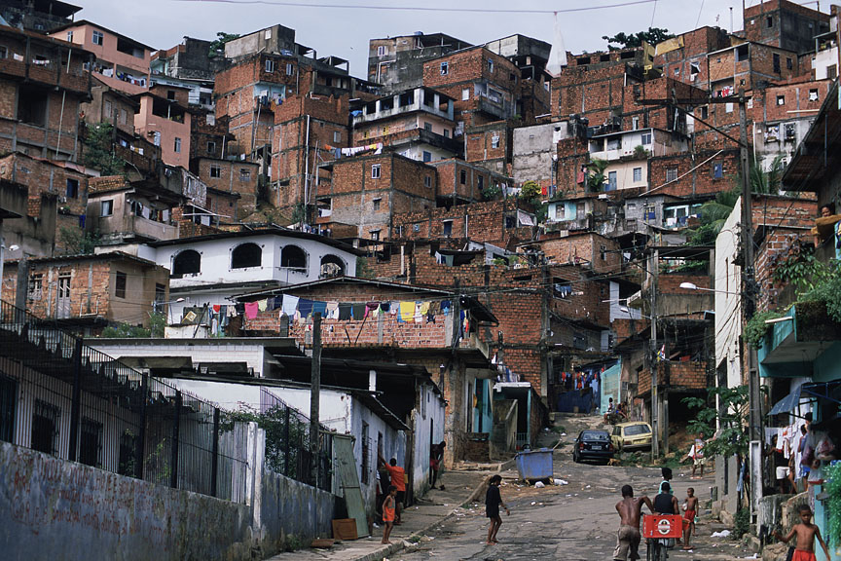
CFCB in São Paulo
Program focus: waste management in favelas
Program Objective: Provide technical assistance to develop an action plan and implement a PoA on waste management in order to harness CERs under the CDM mechanism of the Kyoto Protocol
Wider program integration: CFCB is a supporting component of the NLTA “Green City Development in Brazil”
Next steps:confirm city task team/working group; select local implementation partners; commence program development

Slide 10
Contact
Konrad von Ritter
kritter@worldbank.org

